Slide 1
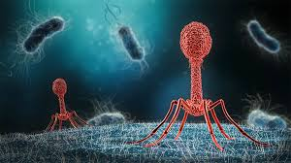
Identifying Top Lysin B Enzymes for Phage Therapy
Exploring Biochemical Properties and Sequence Conservation to Optimize Purification and Efficacy

Slide 2
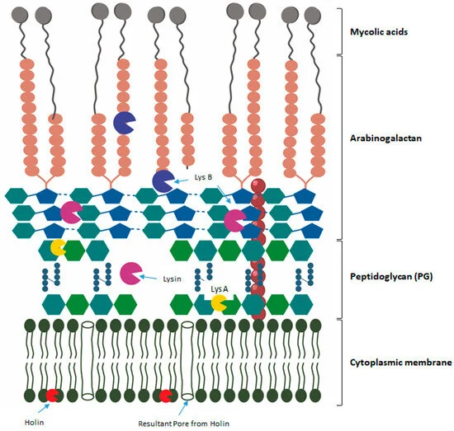
What is Lysin B and its role in bacteriophage therapy?
Lysin B
Produced by bacteriophages and degrades the mycolic acid layer of bacterial cell walls, particularly in Mycobacteria
Therapeutic Applications
Effective lysins must be carefully selected for their ability to target bacteria while being easy to purify for scalable production.
These lysins can enhance other treatments, such as phages or antibiotics, through a combination of computational predictions and experimental validation.

Slide 3
What are the Project Goals and Objectives?
Goals:
Identify top-performing Lysin B enzymes by analyzing biochemical properties and sequence conservation across various bacteriophages.
Prioritize enzymes based on ease of purification and therapeutic potential against antibiotic-resistant Actinobacteria, particularly Mycobacteria.
Objectives
Identify easily purifiable Lysin B enzymes, focusing on physicochemical properties.
Discover sequence conservation among Lysin B enzymes and phages.
Develop machine learning models to predict optimal Lysin B variants with desired properties and conservation
Guide the selection of effective Lysin B enzymes and corresponding phages for therapeutic use against Mycobacteria infections.

Slide 4
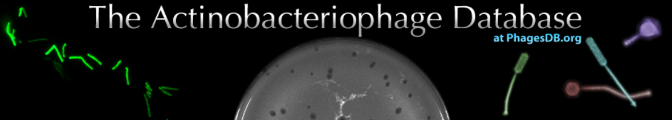
What Data are We Using?
Data Source:
The primary data was fetched from the PhagesDB API: https://phagesdb.org/api/genes/
PhagesDB is a online database dedicated to bacteriophages, including their genomic sequences, structural features, and biological characteristics.
Data Preprocessing
The Notes column was parsed in a Pandas DataFrame to identify entries related to Lysin B.
Rows containing "Lysin B" in the Notes field were filtered and saved into a new DataFrame.
Calculate a Treatment Score using Biochemical and Sequence Conservation Properties

Slide 5
What Additional Features are Important for our Analysis?
Molecular Weight: Total mass; important for size and behavior.
Isoelectric Point (pI): pH with no net charge; affects solubility and purification.
Hydrophobicity: Water repulsion; impacts interaction with bacterial membranes.
Aliphatic Index: Indicates thermostability; higher values suggest greater stability.
Aromaticity: Proportion of aromatic amino acids; influences structural stability.
Instability Index: Predicts stability; lower values indicate higher stability.
Protein Length: Total amino acids; affects function and interactions.
Multiple Sequence Alignment (MSA): Identifies conserved regions of functional importance.
Consensus Sequence: Represents the most common amino acids at each position.
Hamming Distance: Measures similarity to the consensus sequence.

Slide 6
How do we Calculate Treatment Score?
Score Categories:
Stability: Instability Index, Isoelectric Point, Aliphatic Index, Aromaticity.
Hydrophobicity: Gravy Score and Hydrophobicity Score.
Size: Molecular Weight and Protein Length.
Similarity: Hamming Distance from consensus.
Final Treatment Score:
Derived by averaging the four group scores (Stability, Hydrophobicity, Size, Similarity) to rank Lysin B proteins based on stability, solubility, size, and conservation suitability for therapeutic development.

Slide 7
Exploratory Analysis of Lysin B Protein Features
and Treatment Score Correlation
Explore distribution and variability of Lysin B protein features across different Host Strains.
Created histogram and box plots for biochemical features across different host strains
Examine how scaled and encoded features correlate with the Treatment Score of each Lysin B protein.
Created scatter plots for each feature to visualize relationships with the Treatment Score.
Assessed whether relationships were linear or non-linear.

Slide 8
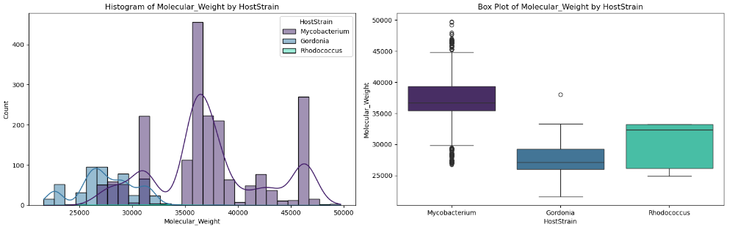
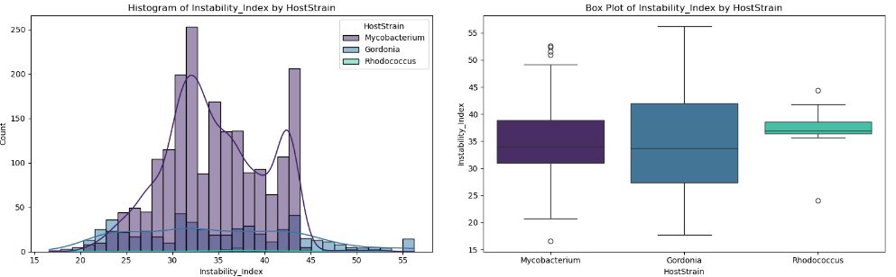
Visualization of Biochemical Properties by Host Strain
Histograms:
Displayed distribution of values for each feature.
Kernel Density Estimate (KDE) overlaid to highlight probability density, differentiated by Host Strain using color coding.
Box Plots:
Illustrated variability of each feature across different host strains.
Enabled comparison of spread and potential outliers in Lysin B protein properties.
Some features exhibited variability between host strains, while others remained more uniform.

Slide 9
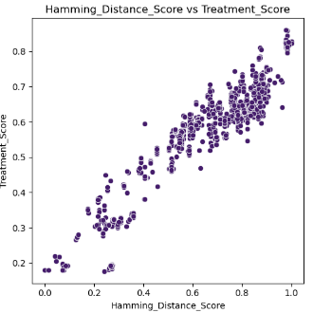
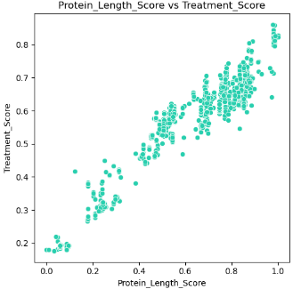
Strong Positive Correlation of Features with Treatment Score
Scatter plots illustrated how features influence the Treatment Score.

Slide 10
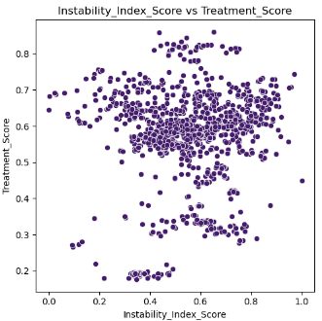
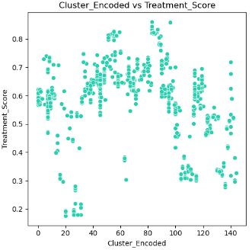
Weak/Complex Correlation of Features with Treatment Score
Scatter plots illustrated how features influence the Treatment Score.

Slide 11
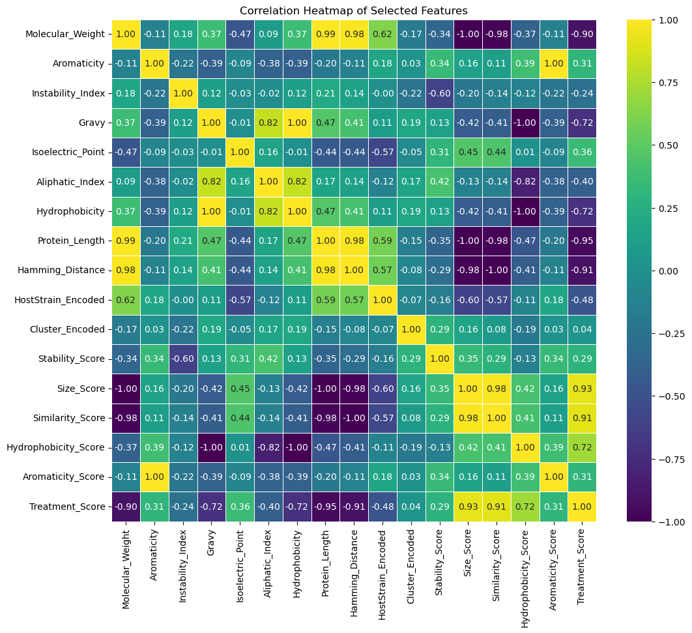
Correlation Heatmap Features vs. Treatment Score
Quantify relationships between various features and the Treatment Score.
Pearson Correlation Coefficients were computed for all features using a Heatmap Correlation Matrix
Strong Correlation
Hydrophobicity Score
Protein Length
Weak Correlation
Cluster Encoded
Instability Index

Slide 12
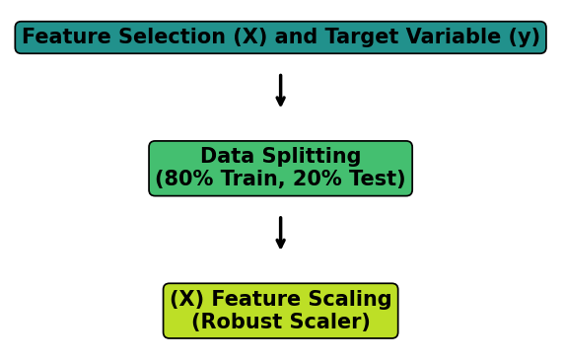
Model Preprocessing
Feature Selection (X)
Isoelectric Point
Aromaticity
Instability Index
Aliphatic Index
Gravy
Hydrophobicity
Molecular Weight
Protein Length
Hamming Distance
HostStrain Encoded
Target Variable (y)
Treatment Score

Slide 13
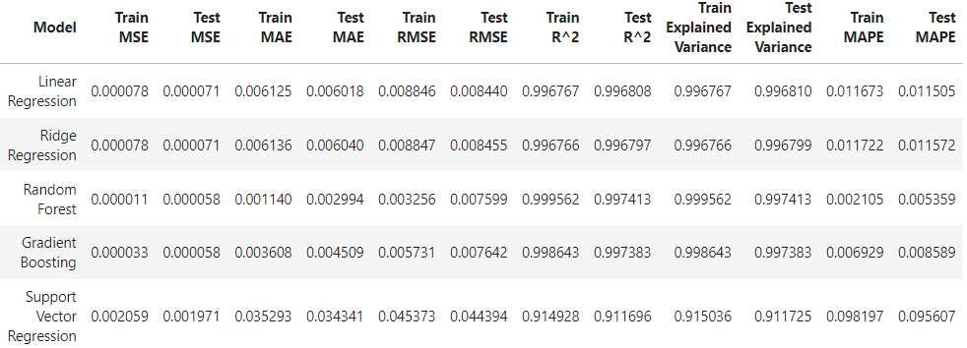
Model Selection, Training, and Performance Metrics
Evaluated multiple machine learning models for Treatment Score predictions
Closer to 0: better performance:
MSE, RMSE, MAE, MAPE
Closer to 1: better performance:
R², Explained Variance

Slide 14
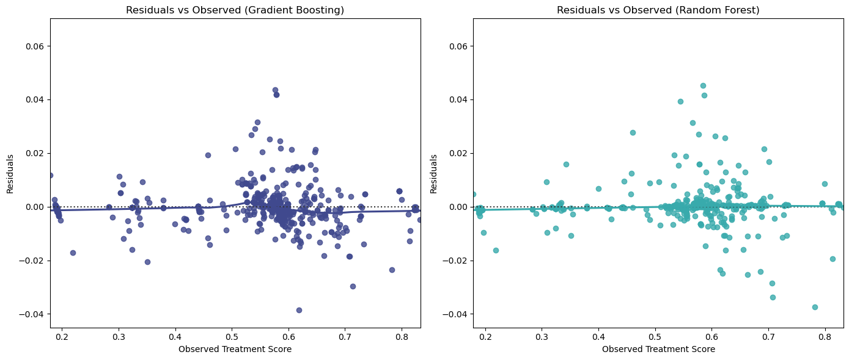
Residual Analysis
Residuals for both models are close to 0, confirming high accuracy between observed and predicted values

Slide 15
GridSearchCV Model Tuning and Evaluation
Random Forest:
Best GridSearch Parameters
n_estimators: 300, max_depth: 20, min_samples_split: 2, min_samples_leaf: 1, max_features: 'sqrt'
Cross Validation Scores
RMSE: 0.00730 ± 0.00121
Gradient Boosting:
Best GridSearch Parameters
n_estimators: 300, learning_rate: 0.05, max_depth: 5, min_samples_split: 2, min_samples_leaf: 4, subsample: 1.0, max_features: 'sqrt'
Cross Validation Scores
RMSE: 0.00549 ± 0.00091
Both models perform well, with Gradient Boosting showing slightly better metrics (lower MSE, RMSE, MAE, and higher R²).
Proceeding with Bayesian Optimization for further tuning of the Gradient Boosting model.

Slide 16
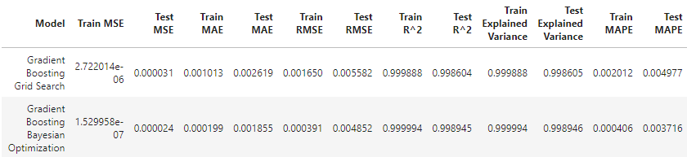
Gradient Boosting with Bayesian Optimization
Best Parameters:
n_estimators: 500
learning_rate: 0.075
max_depth: 10
min_samples_split: 6
min_samples_leaf: 8
subsample: 0.641
max_features: 'log2'
Gradient Boosting with Bayesian Optimization further enhances model predictions, demonstrating improved accuracy across all metrics.

Slide 17
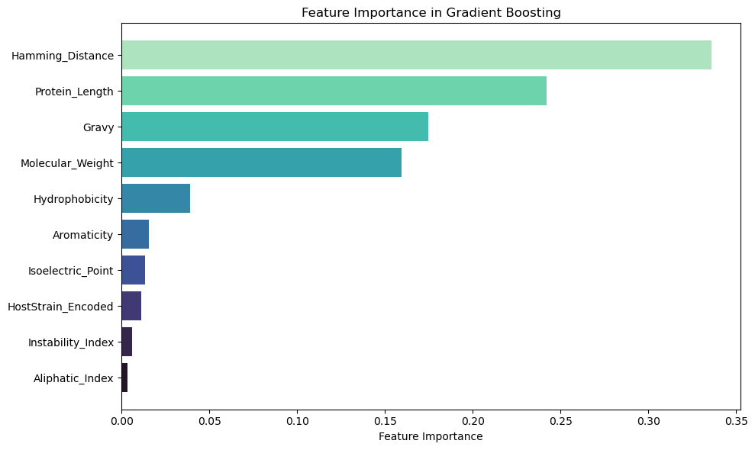
Feature Importance in Gradient Boosting
Hamming Distance and Protein Length are the most influential features in predicting the Treatment Score.
Other important features include Gravy and Molecular Weight, which also contribute significantly to model performance.

Slide 18
Conclusion on Model Performance and Predictive Accuracy
Key Findings:
Best Model: Gradient Boosting Regressor tuned with Bayesian Optimization.
Lowest error metrics: MSE, RMSE, MAE.
Highest R² and Explained Variance scores.
Generalization: Strong performance consistency across training and test sets.
Mean Absolute Percentage Error (MAPE) was low, indicating close predictions to actual Treatment Scores.
Predicted Treatment Scores:
Ranged from 0.177 to 0.859, indicating effectiveness and variability in lysin proteins.
Lower Bound (0.177): Less favorable for therapeutic efficacy and purification.
Upper Bound (0.859): Highly effective proteins with optimal biochemical properties.

Slide 19
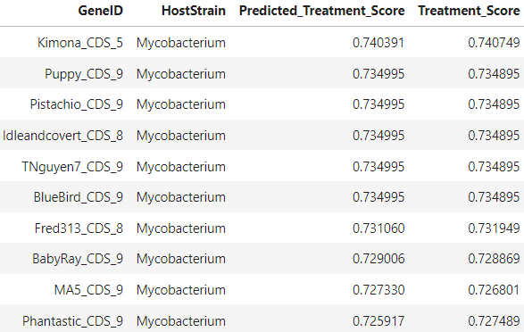
Focus on Mycobacterium Lysin B
Targeting Mycobacterium:
Specific attention to lysins for Mycobacterium strains (e.g., tuberculosis, Mycobacterium abscessus).
Top-performing lysins exhibited high Treatment Scores, indicating their potential for effective purification and efficacy due to their sequence conservation, allowing for treatment across multiple bacterial strains.

Slide 20
Future Project Directions
Incorporating Additional Features:
Integrate biological features to enhance model accuracy:
Protein structural data (e.g., secondary or tertiary structure).
Post-translational modifications affecting stability.
Binding affinities between lysins and bacterial cell walls.
Experimental Validation:
Validate model predictions by testing top-predicted lysins on bacterial cultures.
Assess ease of purification to ensure practical applications in drug development.
Explore combination treatments with phage therapy or antibiotics for enhanced effectiveness.
Overall Objective:
Combine computational predictions with experimental validation to identify effective lysins and improve treatment options.

